Slide 1
DATA ANALYSIS & STATISTICS ASSIGNMENT - I
STUDENT NO: 2058657
CMI3508/CMI7508
World Happiness Report

Slide 2


Motivation
The World Happiness Report is a real study of the state of global happiness. The report continues to receive worldwide attention, since governments, organisations and civil society increasingly use measures of happiness to influence their decision-making.
after
Top experts in all fields – economics, psychology, survey analysis, national statistics, health, public policy and more – describe ways in which well-being measurements can be used effectively to assess national progress. The studies review the state of happiness in today’s world and demonstrate how the modern knowledge of happiness describes personal and national shifts in happiness.
This dataset on World Happiness provides ranking for 156 countries based on the factors: Happiness Score, GDP per capita, Social Support, Healthy life expectancy, Freedom to make life choices, Generosity, Perceptions of corruption. It contains Ordinal variables(Ranking), Nominal variables(Country), Happiness Score, GDP per capita, Social Support, Healthy life expectancy, Freedom to make life choices, Perceptions of corruption are dependent variables as they impact the ranking of the country.
Reference: kaggle. https://www.kaggle.com/unsdsn/world-happiness

Slide 3
Data Cleaning & Manipulation
An initial data summary is taken to describe the count, mean, interquartile ranges, min and max of the numerical variables. This also gives the information on the missing values if present.
Ranking of the countries are the ordinal transformation of the Happiness Score. Ranking and Happiness Score, both imply the same thing.
Happiness score is the response variable in the dataset. The predictor variables are GDP per capita, Social Support, Healthy life expectancy, Freedom to make life choices, Generosity, Perceptions of corruption.
RANKING
GDP
GENEROSITY
CORRUPTION
FREEDOM
HEALTH
SOCIAL
SUPPORT
To start with, an assumption is made that all the variables in this dataset are useful as they all impact the happiness score which in turn impact the country’s happiness ranking. A correlation chart between various variables will give more insight on what variables have higher impact than others.
SCORE

Slide 4
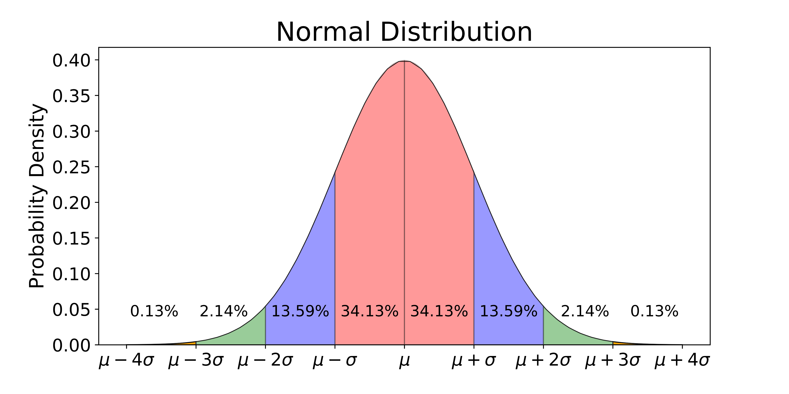
Exploratory Data Analysis - I
Plotting the graph to identify the type of distribution. Assuming normal distribution as below, the rest of the EDA is done:

Slide 5
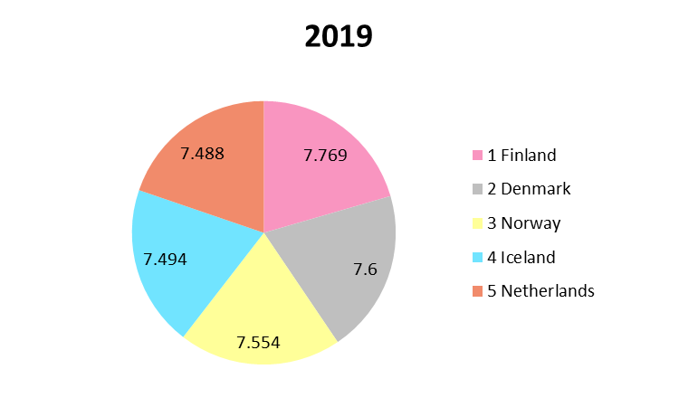
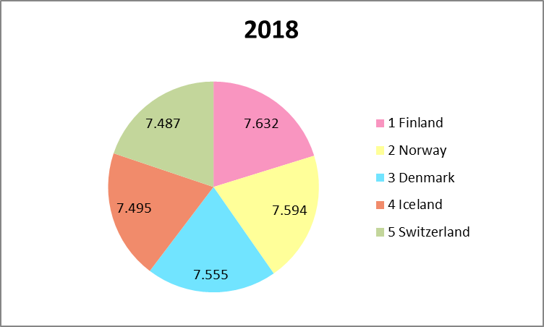
Exploratory Data Analysis - II
A pie chart distribution to understand the happiness of top 5 countries. This mock will be replaced taking all the countries and their proportion ratios after grouping them into continents showing which continent has the most happy countries. This will be compared against time using line charts.
Yearwise Data
TOP 5 Country Ranking in the Year 2019, 2018

Slide 6
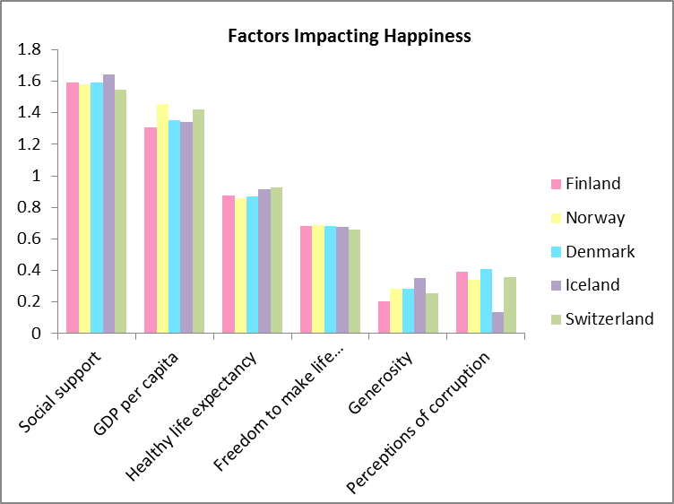
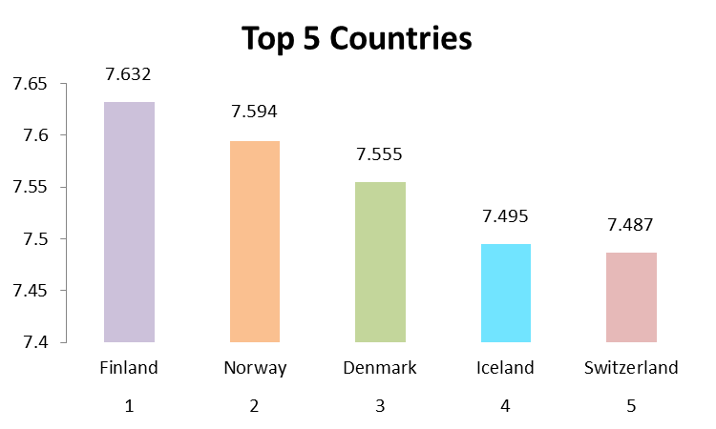
Exploratory Data Analysis - III
Understanding the happiness score from various variables.
Below is a mock which takes top 5 countries and sees how various variables are impacting the happiness in top 5 countries.
Rank Vs Score
Factors Vs Score
Happiness
Score
Country Rank

Slide 7
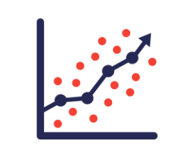
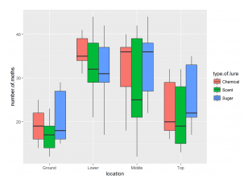
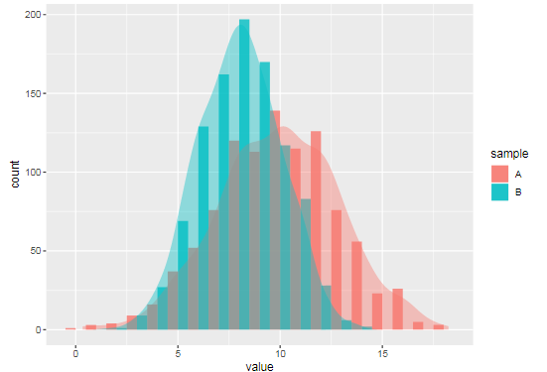
STATISTICAL ANALYSIS
Convert Happiness scores to High and Low Ordinal/Categorical variable and compare the means of the independent variables (GDP per capita) for these groups using t Test.
Convert Happiness scores to High, Medium and Low Ordinal/Categorical variable and compare the means of the independent variables (GDP per capita) for these groups using ANOVA.
Conduct a correlation analysis between the variables.
Run Linear Regression to estimate the relationship between the happiness score and the rest of the variables.
.

Slide 8
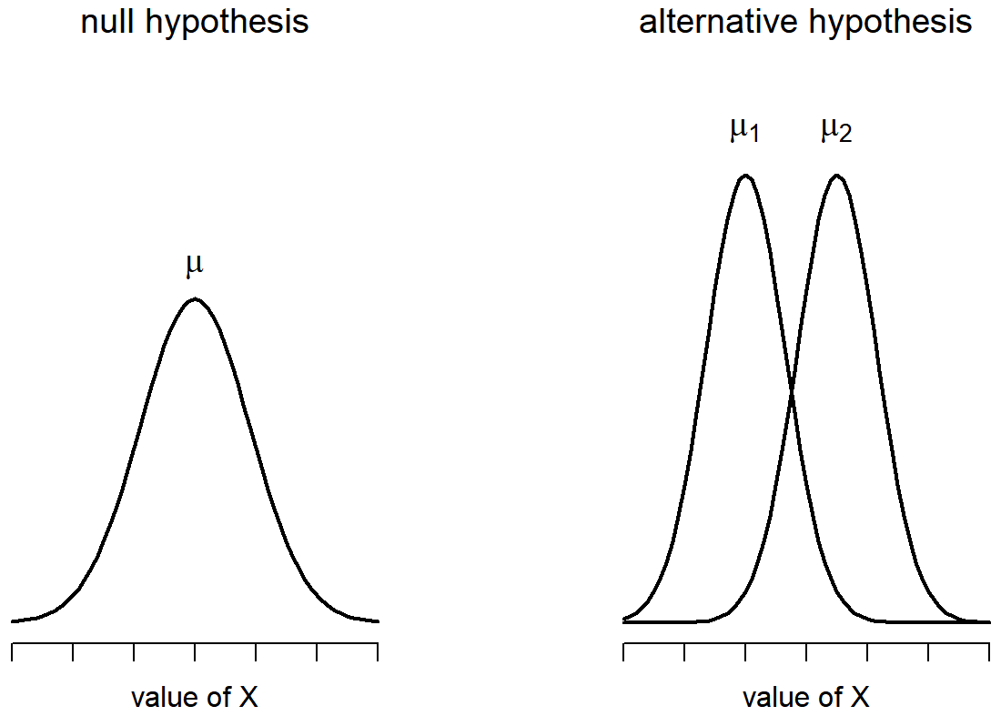
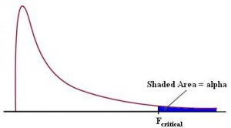
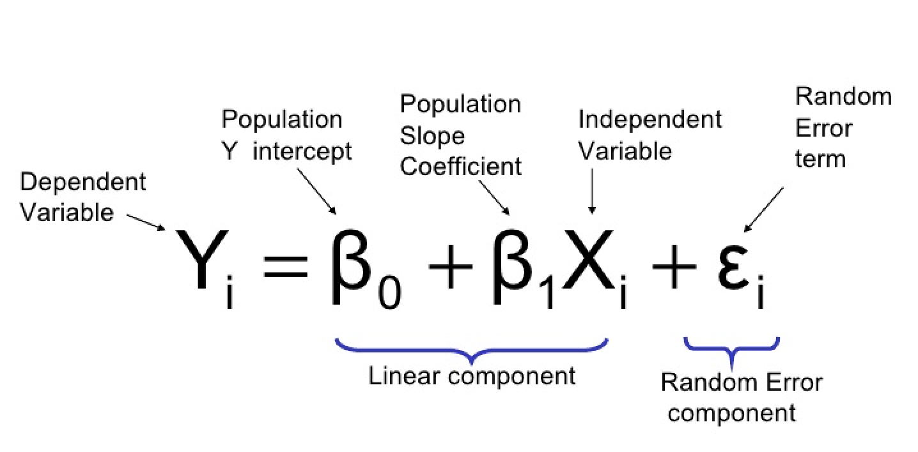
REPORT FINDINGS
First define the Null hypothesis:
H0 = means of the various groups (countries of high happiness scores
vs countries of low happiness scores) are equal.
Run Student t-test:
We take p-value = 0.05 (95% confidence)
If the calculated p-value < p-value(0.05)=> we reject the null hypothesis that the means
of the groups are equal.
Run ANOVA:
Based on value of α and degrees of freedom, extract the F-critical from the F-statistics table.
If the F-value from the Anova test > F-critical, we reject the null hypothesis that the means of the
Groups are equal.
Run regression:
Run a regression analysis to identify the variables which are responsible for happiness score.
Running a linear regression (OLS) will give an intercept and coefficients for various predictor variables.
The coefficients for the predictors will tell how they are related to the dependent variable
(happiness score).

Slide 9
Thank You

